Slide 1

Struktur Data
Trees
Prepared by
Frans Panduwinata, S.Kom, M.T

Slide 2
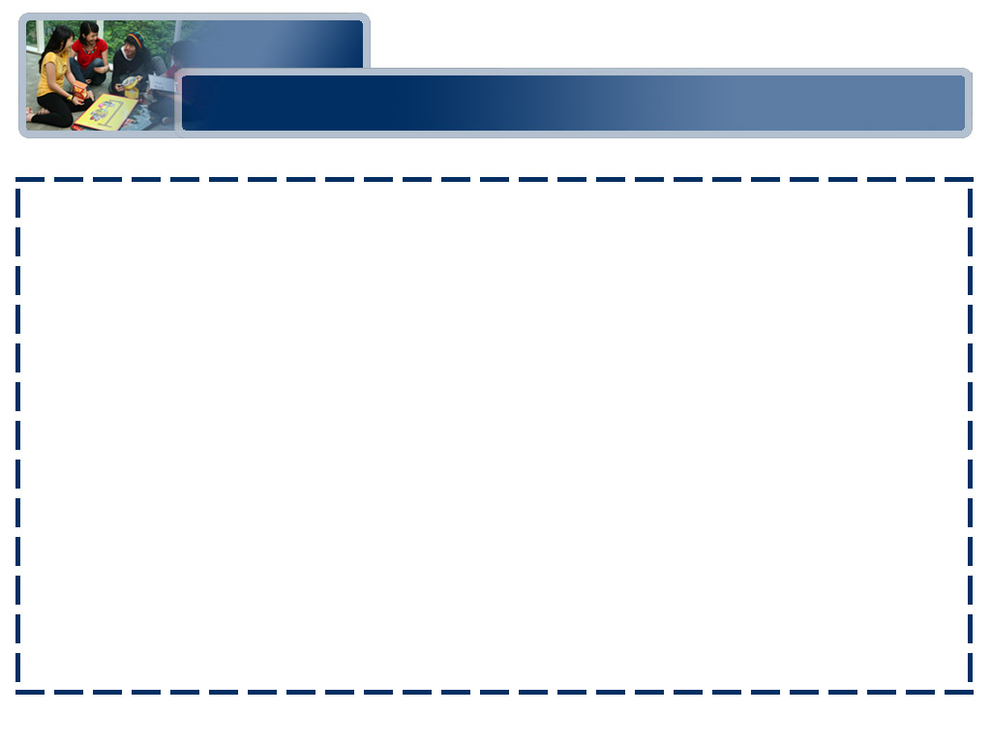
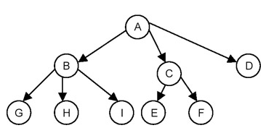
Introduction
A tree is a set of one or more nodes T such that:
  There is a specially designated node called a root
  The remaining nodes are partitioned into n disjointed set of nodes T1, T2,…,Tn, each of which is a tree.
A tree structure:
This is a tree because it is a set of nodes {A,B,C,D,E,F,G,H,I}.
Node A as a root node.
The remaining nodes partitioned into three disjointed sets {B,G,H,I}, { C,E,F} and {D}, respectively.

Slide 3
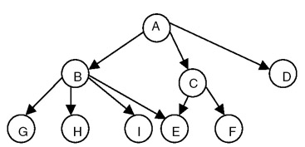
Introduction (cont)
A non-tree structure:
Even though this is a set of nodes {A,B,C,D,E,F,G,H,I}, with node A as a root node, this is not a tree because the fact that node E is shared makes it impossible to partition nodes B through I into disjointed sets.

Slide 4
Introduction (cont)
Degree of a Node of a Tree
  The number of subtrees having this node as a root.
  The number of descendants of a node.
  If the degree is zero, it is called a terminal or leaf node of a tree.
Degree of a Tree
  The maximum of degree of the nodes of the tree.
  Degree of tree = max (degree(node i) for i = 1 to n).

Slide 5
Introduction (cont)
Level of a Node
  We define the level of the node by taking the level of the root node as 1, and
  Incrementing it by 1 as we move from the root towards the subtrees.
  So the level of all the descendants of the root nodes will be 2.
  The level of their descendants will be 3, and so on.
  We then define the depth of the tree to be the maximum value of the level of the node of the tree.

Slide 6
Binary Tree
A binary tree is a special case of tree as defined in the preceding section, in which NO node of a tree can have a degree of more than 2.
Therefore, a binary tree is a set of zero or more nodes T such that:
  There is a specially designated node called the root of the tree
  The remaining nodes are partitioned into two disjointed sets, T1 and T2, each of which is a binary tree. T1 is called the left subtree and T2 is called right subtree, or vice-versa.

Slide 7
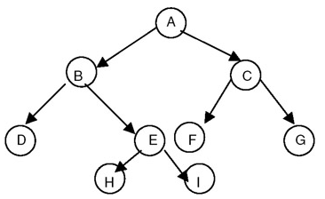
Binary Tree (cont)
Binary tree structure:
So, for a binary tree we find that:
  The maximum number of nodes at level i will be 2^{i−1}
  If k is the depth of the tree then the maximum number of nodes that the tree can have is
  2^{k} − 1 = 2^{k−1} + 2^{k−2} + … + 2⁰

Slide 8
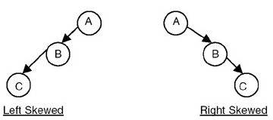
Binary Tree (cont)
Skewed binary trees:

Slide 9
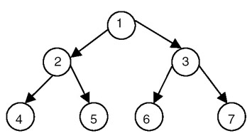
Binary Tree (cont)
A full binary tree:
A full binary tree is a binary of depth k having 2^{k} − 1 nodes.
If it has < 2^{k} − 1, it is not a full binary tree.
For EXAMPLE, for k = 3,
the number of nodes = 2^{k} − 1 = 2³ − 1 = 8 − 1 = 7.
If a binary tree is full, then we can number its nodes sequentially from 1 to 2^{k−1}, starting from the root node, and at every level numbering the nodes from left to right.

Slide 10
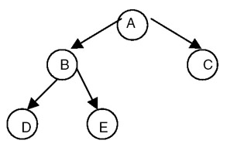
Binary Tree (cont)
A complete binary tree:
Special case of a binary tree, in which all the levels, except perhaps the last, are full; while on the last level, any missing nodes are to the right of all the nodes that are present.

Slide 11
Representation of a Binary Tree
In general, any binary tree can be represented using an array.
An array representation of a complete binary tree does not lead to the waste of any storage.
But if you want to represent a binary tree that is not a complete binary tree using an array representation, then it leads to the waste of storage.

Slide 12
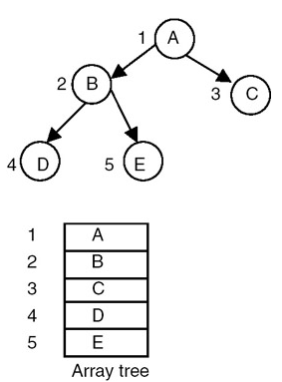
Representation of a Binary Tree (cont)
An array representation of a complete binary tree having 5 nodes and depth 3.

Slide 13
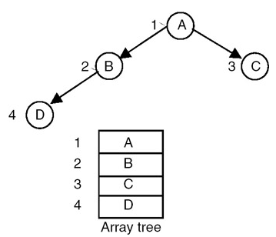
Representation of a Binary Tree (cont)
An array representation of a complete binary tree with 4 nodes and depth 3.

Slide 14
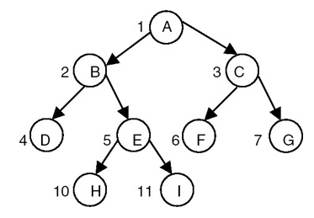
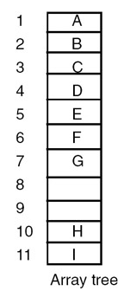
Representation of a Binary Tree (cont)
An array representation of a binary tree.

Slide 15
Representation of a Binary Tree (cont)
An array representation of a binary tree is not suitable for frequent insertions and deletions, even though no storage is wasted if the binary tree is a complete binary tree.
Therefore, instead of using an array representation, we can use a linked representation, in which every node is represented as a structure with three fields:
  one for holding data,
  one for linking it with the left subtree, and
  the third for linking it with right subtree.

Slide 16
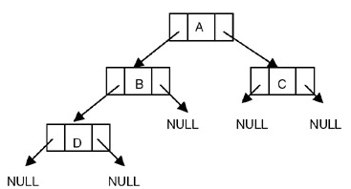

Representation of a Binary Tree (cont)
Linked representation structure:
struct tnode
{
int data
struct tnode *lchild,*rchild;
};

Slide 17
Binary Tree Traversal
Order of Traversal of Binary Tree
The following are the possible orders in which a binary tree can be traversed:
  LDR LRD DLR
  RDL RLD DRL
where:
L stands for traversing the left subtree,
R stands for traversing the right subtree, and
D stands for processing the data of the node.

Slide 18
Binary Tree Traversal (cont)
The order LDR is the order of traversal in which
  We start with the root node,
  visit the left subtree,
  process the data of the root node, and
  then visit the right subtree.
  Since the left and right subtrees are also the binary trees, the same procedure is used recursively while visiting the left and right subtrees.

Slide 19
Binary Tree Traversal (cont)
The order
  LDR is called as inorder
  A systematic way of visiting all nodes in a binary tree that visits the nodes in the left subtree of a node, then visits the node, and then visits the nodes in the right subtree of the node.
  LRD is called as postorder
  A systematic way of visiting all nodes in a binary tree that visits the nodes in the left subtree of a node, then visits the nodes in the right subtree of the node, and then visits the node.

Slide 20
Binary Tree Traversal (cont)
The order (cont)
  DLR is called as preorder
  A systematic way of visiting all nodes in a binary tree that visits a node, then visits the nodes in the left subtree of the node, and then visits the nodes in the right subtree of the node.
  The remaining three orders are not used.

Slide 21
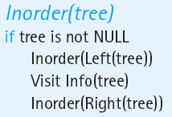
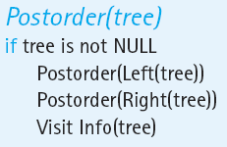
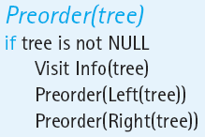
Binary Tree Traversal (cont)
Comparison three traversals algorithms.

Slide 22
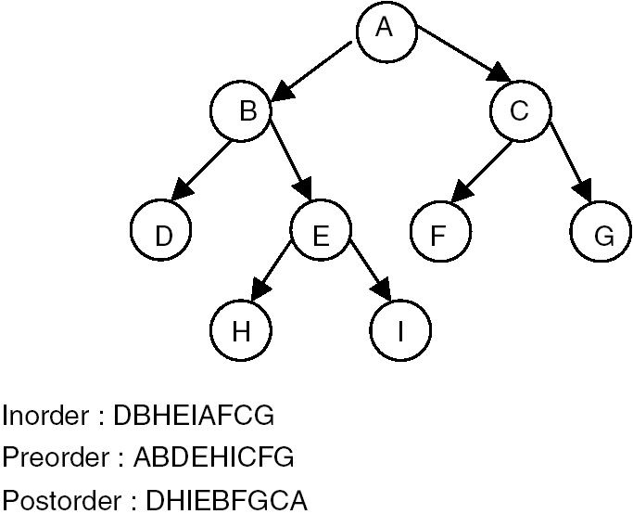
Binary Tree Traversal (cont)
A binary tree along with its inorder, preorder and postorder

Slide 23
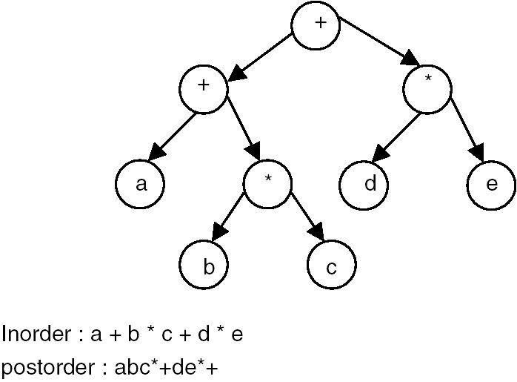
Binary Tree Traversal (cont)
The inorder traversal of the tree gives us an infix expression, whereas the postorder traversal gives us a postfix expression

Slide 24
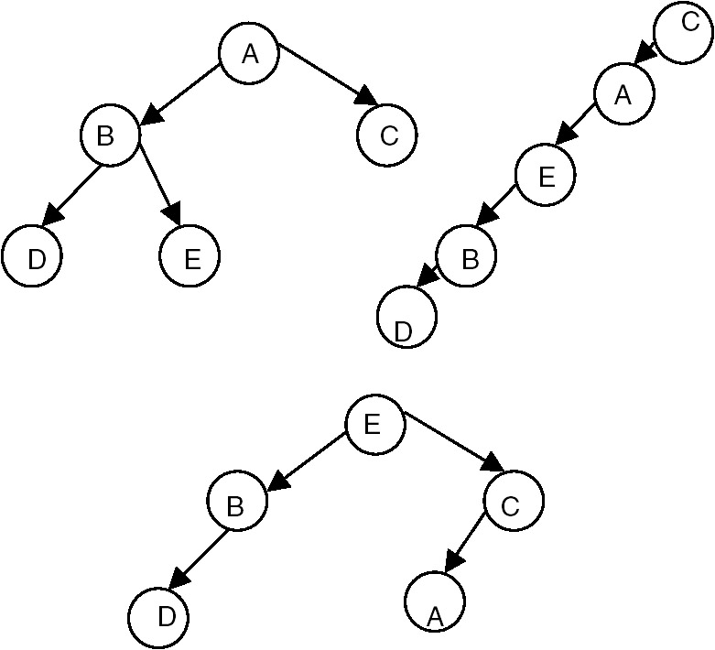
Binary Tree Traversal (cont)
Inorder = DBEAC
Given only one order of traversal of a tree, it is possible to construct a number of binary trees.

Slide 25
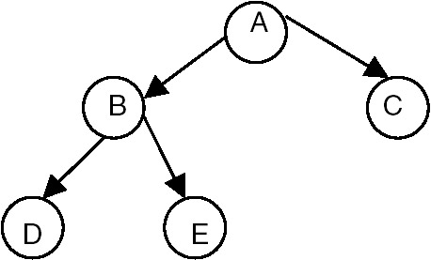
Binary Tree Traversal (cont)
A unique binary tree cannot be constructed with only one order of traversal. For construction of a unique binary tree, we require two orders.
Inorder = DBEAC
Postorder = DEBCA

Slide 26
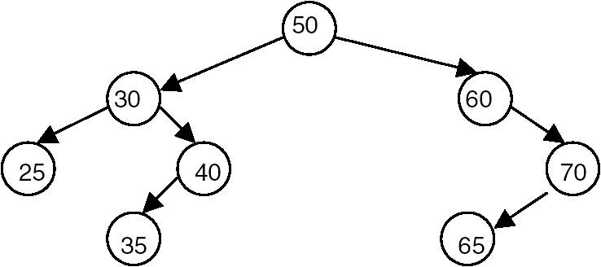
Binary Search Tree (BST)
Binary search tree
A binary tree in which the key value in any node is greater than the key value in its left child and any of its children (the nodes in the left subtree) and less than the key value in its right child and any of its children (the nodes in the right subtree).
EXAMPLE:

Slide 27
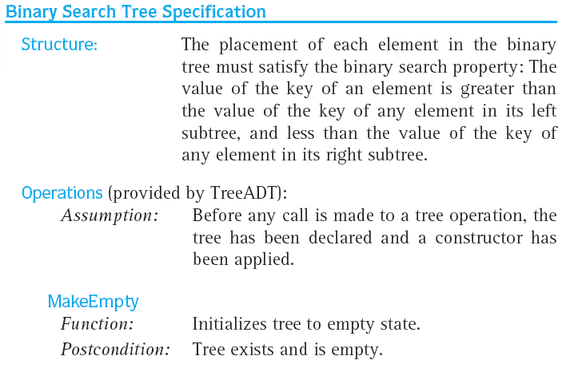
Binary Search Tree (BST) (cont)

Slide 28
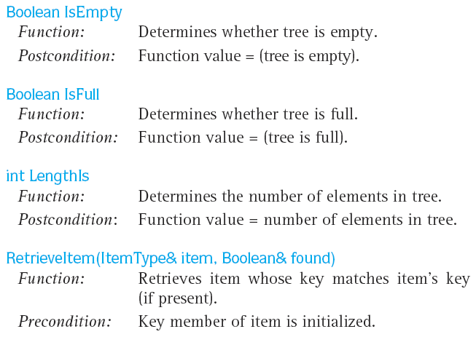
Binary Search Tree (BST) (cont)

Slide 29
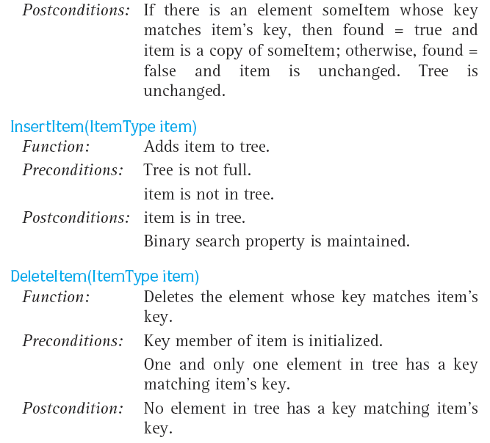
Binary Search Tree (BST) (cont)

Slide 30
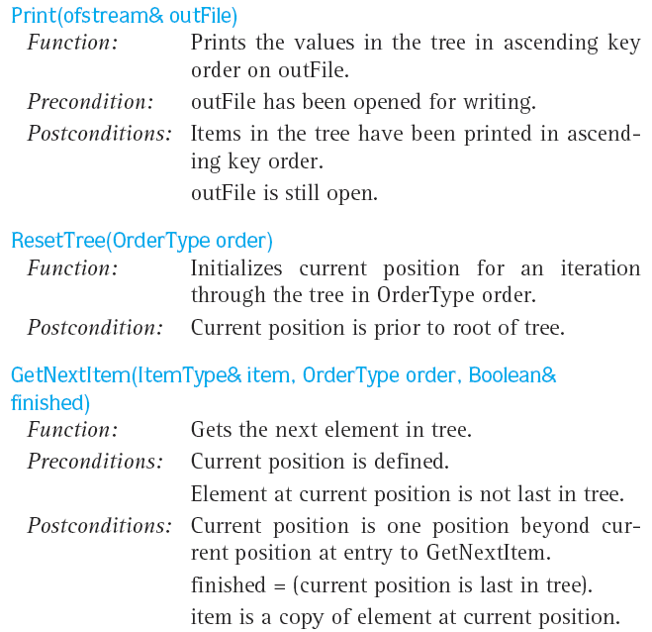
Binary Search Tree (BST) (cont)

Slide 31
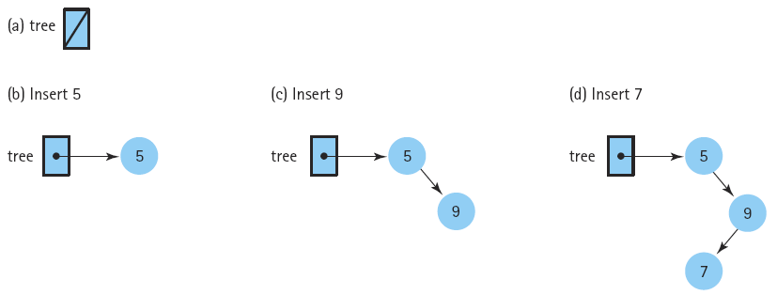
Binary Search Tree (BST) (cont)
Insertions into a binary search tree

Slide 32
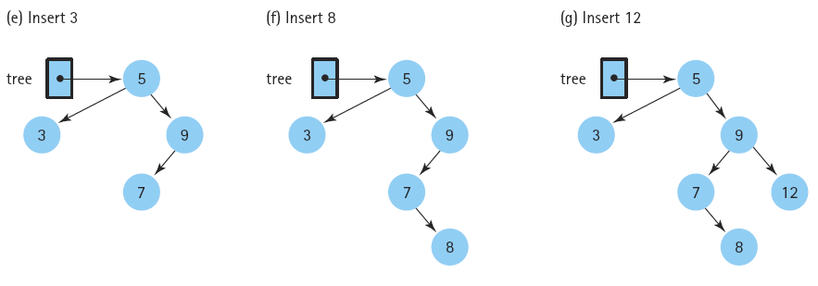
Binary Search Tree (BST) (cont)
Insertions into a binary search tree (cont)

Slide 33
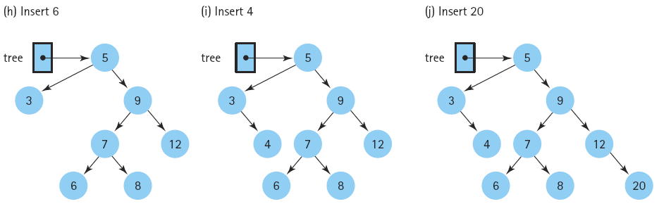
Binary Search Tree (BST) (cont)
Insertions into a binary search tree (cont)

Slide 34
Binary Search Tree (BST) (cont)
Deletion of a node
  Deleting a leaf (no children).
  Deleting a node with only one child.
  Deleting a node with two children.

Slide 35
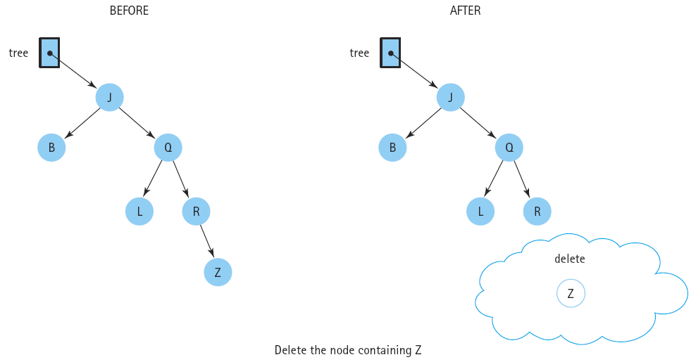
Binary Search Tree (BST) (cont)
Deleting a leaf node

Slide 36
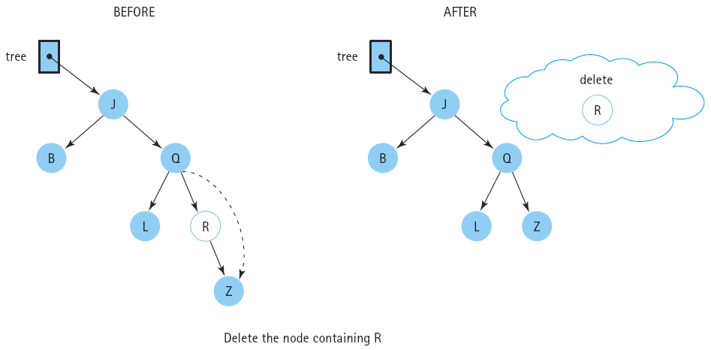
Binary Search Tree (BST) (cont)
Deleting a node with one child

Slide 37
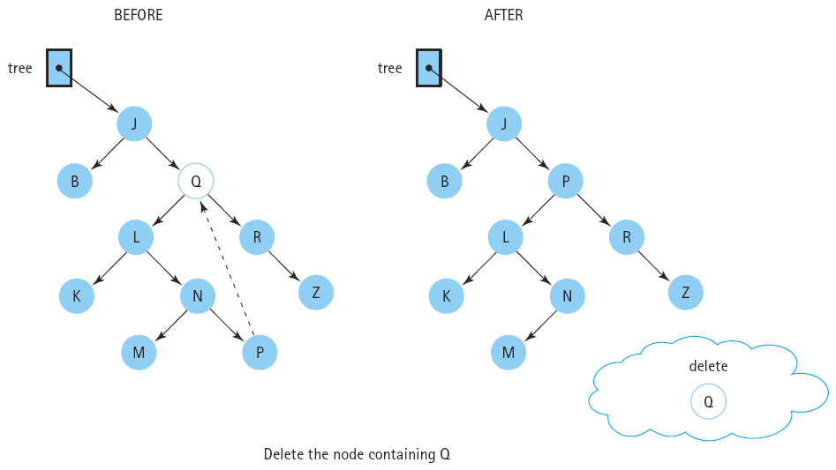
Binary Search Tree (BST) (cont)
Deleting a node with two children.

Slide 38
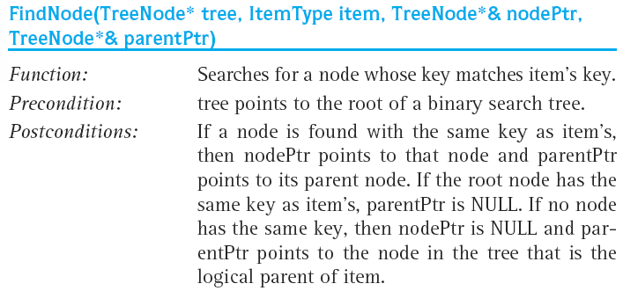
Binary Search Tree (BST) (cont)
Find a node

Slide 39
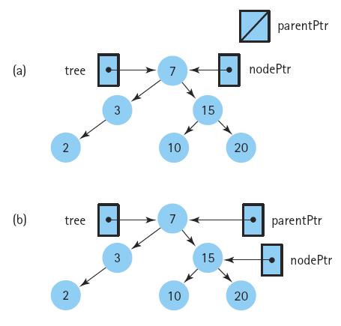
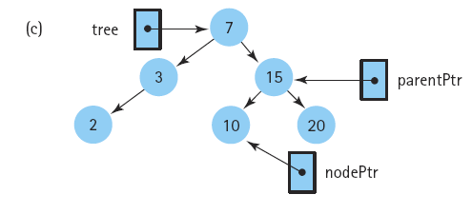
Binary Search Tree (BST) (cont)
Using the function FindNode to find the insertion point

Slide 40
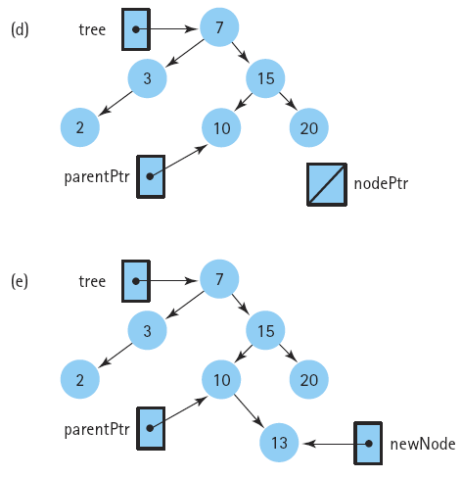
Binary Search Tree (BST) (cont)
Using the function FindNode to find the insertion point (cont)

Slide 41
Exercises
Draw the binary search tree whose elements are inserted in the following order?
50 72 96 94 107 26 12 11 9 2 10 25 51 16 17 95
Show the order in which the nodes in the tree (no 1) are processed by
  an inorder traversal of the tree
  a postorder traversal of the tree
  a preorder traversal of the tree

Slide 42
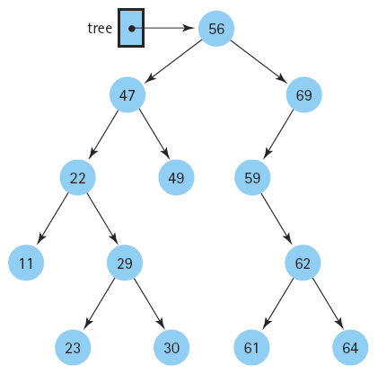
Exercises (cont)
Show how the tree would look after the deletion of 29, 59, and 47.
Show how the (original) tree would look after the insertion of nodes containing 63, 77, 76, 48, 9, and 10 (in that order).

